Slide 1
PERSONALITY DISORDERS
Dr. Mojtaba Beyooseh
16TH Dec, 2015

Slide 3
Definition of terms
Personality Disorders can be defined broadly as inflexible and maladaptive patterns of behaviour.
They are pervasive, persistent, inflexible, maladaptive patterns of behaviour that deviate from expected cultural norms. They cause significant distress or functional impairment. Diagnosis is clinical. Treatment is with psychotherapy and sometimes drug therapy.
Personality disorder, as defined in the Diagnostic and Statistical Manual of the American Psychiatric Association, Fourth Edition, Text Revision (DSM-IV-TR), is an enduring pattern of inner experience and behavior that differs markedly from the expectations of the individual's culture, is pervasive and inflexible, has an onset in adolescence or early adulthood, is stable over time, and leads to distress or impairment.
Personality disorders are a long-standing and maladaptive pattern of perceiving and responding to other people and to stressful circumstances.
Ten personality disorders, grouped into 3 clusters (i.e, A, B, C), are defined in the DSM-IV-TR

Slide 4
An Overview of Human Personality!
Personality is the combination of thoughts, emotions and behaviors that makes you unique. It's the way you view, understand and relate to the outside world, as well as how you see yourself. Personality forms during childhood, shaped through an interaction of two factors:
  Inherited tendencies, or your genes. These are aspects of your personality passed on to you by your parents, such as shyness or having a happy outlook. This is sometimes called your temperament. It's the "nature" part of the nature vs. nurture debate.
  Environment, or your life situations. This is the surroundings you grew up in, events that occurred, and relationships with family members and others. It includes such things as the type of parenting you had, whether loving or abusive. This is the "nurture" part of the nature vs. nurture debate.

Slide 5
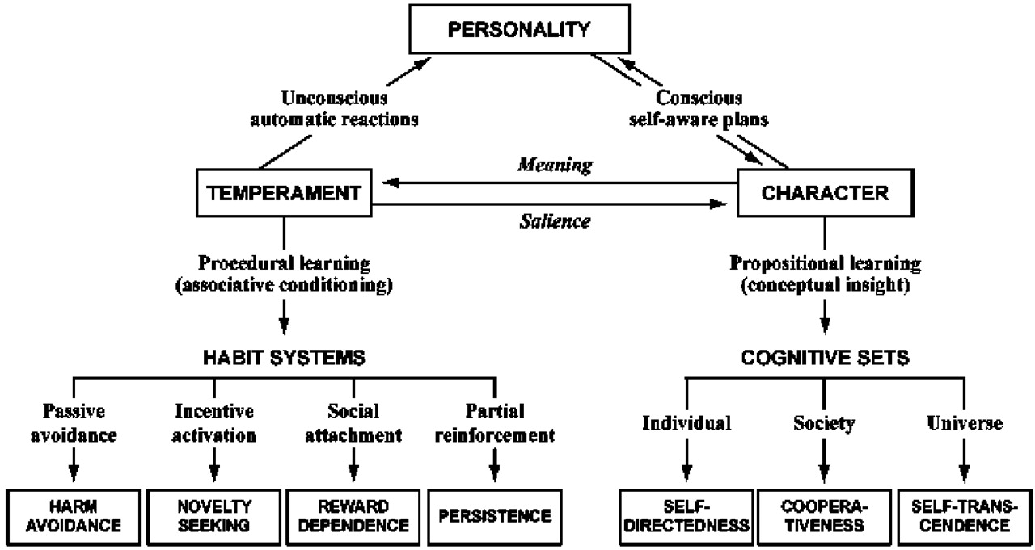
An Overview of Human Personality!

Slide 6
Overview of Clusters
Basically, Personality Disorders, PDs, are things people do that probably annoy everybody else but as far as we are concern, we are okay and its everyone else who have the problem. Thinking about this in the psychiatric terms, PDs patients tend to be egosyntonic, meaning they are okay with themselves and happy with the way they are.
CLUSTERS
  A- Odd eccentric type includes paranoid, schizoid and schizotypal)
  B – Dramatic emotional type includes borderline, narcissistic, histrionic and antisocial
  C - Anxious – Fearful type includes avoidance, obsessive-compulsive and dependent.
  Not specified – Depressive, passive-aggressive, Sadistic and Self-defeating.

Slide 7
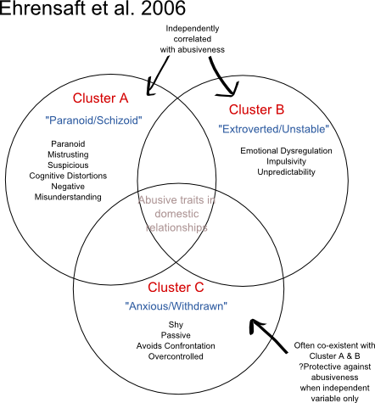
Overview of Clusters

Slide 8
Incidence
Because the DSM-IV-TR criteria are so bound to North American cultural definitions, epidemiologic data about personality disorders in other countries are notoriously unreliable, but nonetheless the incidence ranges between 5-10% of the general population.
Taking the United State as a case study, personality disorders affect 10-15% of the adult US population. Individuals may have more than one personality disorder. The following are prevalences for specific personality disorders in the general population:
  Paranoid personality disorder - 0.5-2.5%
  Schizotypal (Schizoid) personality disorder - 3%
  Antisocial personality disorder - 3% of men, 1% of women
  Borderline personality disorder - 2%
  Histrionic personality disorder - 2-3%
  Narcissistic personality disorder - Less than 1%
  Avoidant personality disorder - 0.5-1%
  Obsessive-compulsive personality disorder - 1%

Slide 9
Epidemiological Facts
Race: No differences in prevalence across the races have been noted.
Sex
  Cluster A: Schizoid personality disorder is slightly more common in males than in females.
  Cluster B: Antisocial personality disorder is 3 times more prevalent in men than in women. Borderline personality disorder is 3 times more common in women than in men. Of patients with narcissistic personality disorder, 50-75% are male.
  Cluster C: Obsessive-compulsive personality disorder is diagnosed twice as often in men than in women.
Age: Personality disorders generally should not be diagnosed in children and adolescents because personality development is not complete and symptomatic traits may not persist into adulthood. Therefore, the rule of thumb is that personality diagnosis cannot be made until the person is at least 18 years of age. Because the criteria for diagnosis of personality disorders are closely related to behaviors of young and middle adulthood, DSM-IV-TR diagnoses of personality disorders are notoriously unreliable in the elderly population.
Mortality/Morbidity: Risk of death is usually related to conditions or behaviors resulting from the disorder, such as suicide, substance abuse, or injuries from motor vehicle accidents and fighting.

Slide 10
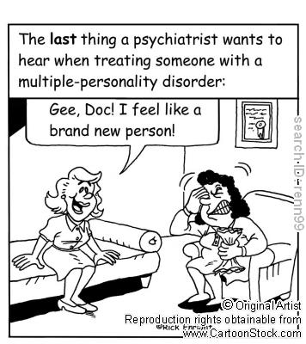
Clinical Features
General symptoms of a personality disorder
  Frequent mood swings
  Stormy relationships
  Social isolation
  Angry outbursts
  Suspicion and mistrust of others
  Difficulty making friends
  A need for instant gratification
  Poor impulse control
  Alcohol or substance abuse

Slide 11
CLUSTER B

Slide 12


Slide 13
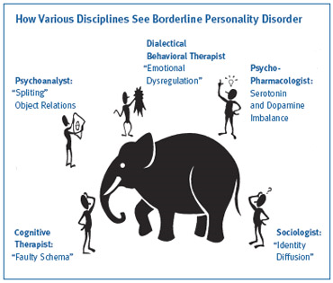
Cluster B – Borderline

Slide 14
Cluster B – Borderline
The central feature of borderline personality disorder is a pervasive pattern of unstable and intense interpersonal relationships, self-perception, and moods. Impulse control is markedly impaired.
Transiently, such patients may appear psychotic because of the intensity of their distortions.
Borderline personality disorder is one of the most commonly overused diagnoses in DSM-IV.
Diagnostic criteria require at least 5 of the following features:
    Frantic efforts to avoid expected abandonment;
    Unstable and intense interpersonal relationships characterized by alternating between extremes of idealization and devaluation;

Slide 15
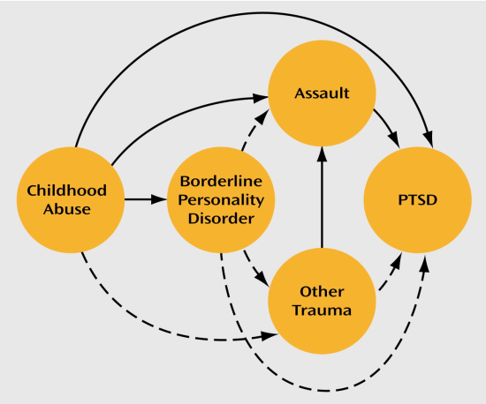
Cluster B – Borderline
    Identity disturbance, that is, markedly and persistently disturbed, distorted, or unstable self-image or sense of self
    Impulsivity in at least 2 areas that are potentially self-damaging (e.g., sex, substance abuse, reckless driving)
    Recurrent suicidal behaviors or threats or self-mutilation behavior
    Affective instability due to a marked reactivity of mood
    Chronic feelings of emptiness
    Inappropriate and intense anger or lack of control of anger
    Transient paranoia or dissociation

Slide 16
Cluster B – Borderline
This disorder may be present in 1-2 % of the population. The diagnosis is made twice as frequently in women. Of the individuals with this diagnosis 90 % also have one of other psychiatric diagnosis and 40 % have two other diagnoses.
Summarily, borderline personality disorder is marked by unstable self-image, mood, behavior, and relationships. Affected people are often hypertensive; they tend to believe they were deprived of adequate care during childhood and consequently feel empty, angry, and entitled to nurturance. As a result, they relentlessly seek care and are sensitive to its perceived absence. Their relationships tend to be intense and dramatic. When feeling cared for, they appear like lonely waifs who seek help for depression, substance abuse, eating disorders, and past mistreatments.

Slide 17
Cluster B – Borderline
When they fear the loss of the caring person, they frequently express inappropriate intense anger. These mood shifts are typically accompanied by extreme changes in their views of the world, themselves, and other people – e.g. from bad to good, from hated to loved. When they feel abandoned, they dissociate or become desperately impulsive. Their concept of reality is sometimes so poor that they have brief episodes of psychotic thinking, such as paranoid delusions and hallucinations. They often become self-destructive and may cut themselves (self-mutilate) or attempt suicide. They initially tend to evoke intense, nurturing responses on caretakers, but after repeated crises, vague unfounded complaints, and failure to adhere to therapeutic recommendations, they are viewed as help-rejecting complainers.
Borderline personality tends to become milder or to stabilize with aging.

Slide 19
Cluster B – Narcissistic
A pervasive pattern of grandiosity, need for admiration, and a lack of empathy. Characterized by self-importance, preoccupations with fantasies, belief that they are special, including a sense of entitlement and a need for excessive admiration, and extreme levels of jealousy and arrogance.
Individuals have a grandiose sense of their own importance but are also extremely sensitive to criticism. They have little ability to empathize with others, and they are more concerned about appearance than substance. Narcissistic patients have a pervasive pattern of grandiosity, need for admiration, and lack of empathy that begins in early adulthood and is present in a variety of contexts. Narcissistic personality disorder is indicated by at least 5 of the following:
  A grandiose sense of self-importance (e.g., exaggeration of achievements and talents, expectation for recognition as superior without commensurate achievements)

Slide 20
Cluster B – Narcissistic
  Preoccupation with fantasies of unlimited success, power, brilliance, beauty, or ideal love
  Belief that she is “special” and unique and can only be understood by, or should associate with, other special or high-status people (or institutions)
  Requirement for excessive admiration
  A sense of entitlement (i.e., unreasonable expectations of especially favorable treatment or automatic compliance with her views)
  Behavior that is interpersonally exploitative (i.e., takes advantage of others as a means to achieve her own ends)
  Lack of empathy (i.e., unwilling to recognize or identify with the feelings and needs of others)

Slide 21
Cluster B – Narcissistic
  Jealousy or belief that others are envious of her
  Arrogance, demonstration of haughty behavior or attitude
Summarily, Narcissistic personality involves grandiosity. Affected individuals have an exaggerated sense of superiority and expect to be treated with deference and preference. Their relationships are characterized by a need to be admired, and they are extremely sensitive to criticism, failure, or defeat. When confronted with a failure to fulfill their high opinion of themselves, they can become enraged or seriously depressed and suicidal. The often believe other people envy them. They may exploit other because they think their superiority justifies it.

Slide 22


Slide 23
Cluster B – Histrionic
Excessive emotionality and attention-seeking behavior.
Patients with histrionic personality disorder display excessive emotionality and attention-seeking behavior. They are quite dramatic and often sexually provocative or seductive. Their emotions are labile.
In clinical settings, their tendency to vague and impressionistic speech is often highlighted. A pervasive pattern of excessive emotionality and attention seeking that begins by early adulthood and is present in a variety of contexts is characteristic. Histrionic personality disorder is indicated by at least 5 of the following:
  Feeling of discomfort in situations in which she is not the center of attention
  Interaction with others that is often characterized as inappropriately sexually seductive of provocative

Slide 24
Cluster B – Histrionic
  Insincere affect (i.e., display of rapidly shifting and shallow expression of emotions)
  Consistent use of physical appearance to draw attention to herself
  Speech that is excessively impressionistic and lacking in detail
  Self-dramatization, with a theatrical and exaggerated expression of emotion
  Suggestibility (i.e., easily influenced by others or circumstances)
  Exaggeration of importance of relationships and acquaintances
The prevalence of histrionic personality disorder is not known with certainty. The condition, which is thought to be common, is diagnosed in women much more often than in men. Men who exhibit similar behavior patterns are often diagnosed as narcissistic.

Slide 25
Cluster B – Histrionic
Summarily, Histrionic personality involves conspicuous attention seeking. Affected people are also overly conscious of appearance and are dramatic. Their expression of emotions often seems exaggerated, childish, and superficial. Still, they frequently evoke sympathetic or erotic attention from other people. Relationships are often easily established and overly sexualized but tend to be superficial and transient. Behind their seductive behaviors and their tendency to exaggerate somatic problems (i.e. hypochondria) often lie more basic wishes for dependency and protection.

Slide 26


Slide 27
Cluster B – Antisocial
Chronic maladaptive behavior that disregards the rights of others.
Individuals with antisocial personality disorder display a pervasive pattern of disregard for and violation of the rights of others and the rules of society. Individuals have a history of continuous and chronic antisocial behavior in which the rights of others are violated.
  The essential defect is one of character structure in which affected individuals are seemingly unable to control their impulses and postpone immediate gratification.
  Affected individuals lack sensitivity to the feelings of others. They are egocentric, selfish, and excessively demanding, in addition, they are usually free of anxiety, remorse, and quilt.
  Violation of the law and customs of the local community is characteristic. The terms “sociopath” and “psychopath” have been applied to individuals with particularly deviant antisocial personalities.
  Personality disorders are considered lifelong conditions, and the signs of conduct disorder must be present in adolescence. The criteria for conduct disorder should be met.
  Persons who use illegal substances satisfy many of the criteria of antisocial personality disorder as a result of their pursuit of these substances. However, the diagnosis of antisocial personality disorder is not appropriate if the only diagnostic criteria are all drug related and the patients shows some remorse about victimizing others.

Slide 28
Cluster B – Antisocial
Factors indicative of antisocial personality disorder include:
  Current age of 18 years or older
  Evidence of a conduct disorder with onset before age 15
  A pervasive pattern of disregard for and violation of the rights of others occurring since age 15, as indicated by at least 3 of the following:
    Failure to conform to social norms with respect to lawful behaviors as indicated by repeatedly performing acts that are grounds for arrest
    Irritability and aggressiveness, as indicated by repeated physical fights or assaults
    Consistent irresponsibility, as indicated by repeated failure to sustain consistent work behavior or honor financial obligations
    Impulsivity or failure to plan ahead
    Deceitfulness, as indicated by repeated lying, use of aliases, or conning others for personal profit or pleasure
    Reckless disregard for safety of self or others
    Lack of remorse, as indicated by being indifferent to or rationalizing having hurt, mistreated, or stolen from another person
  Antisocial behavior that does not occur exclusively during the course of schizophrenia or a manic episode.

Slide 29
Cluster B – Antisocial
Summarily, Antisocial personality is marked by the callous disregard for the rights and feelings of other people. Affected people exploit others for materialistic gain or personal gratification. They become frustrated easily and tolerate frustration poorly. Characteristically, they act out their conflicts impulsively and irresponsibly, sometimes with hostility and violence. They usually do not anticipate the consequence of their behaviors and typically do not feel remorse or guilt afterwards. Many of them have a well-developed capacity for glibly rationalizing their behavior or blaming it on others. Dishonesty and deceit permeate their relationships. Punishment rarely modifies their behavior or improves their judgment. Antisocial personality often leads to alcoholism, drug addiction, promiscuity, failure to fulfill responsibilities, frequent relocation, and difficulty abiding by laws. Life expectancy is decreased, but the disorder tends to diminish or stabilize with age.

Slide 30
Investigations
Toxicology screen: Substance abuse is common in many personality disorders, and intoxication can lead patients to present with some features of personality disorders.
Screening for HIV and other sexually transmitted diseases: Patients with personality disorders often exhibit poor impulse control and many act without regard to risk.
Psychological testing may support or direct the clinical diagnosis.
  The Minnesota Multiphasic Personality Inventory (MMPI) is the best-known psychological test. The Eysenck Personality Inventory and the Personality Diagnostic Questionnaire are also used. None of these has been reliably validated against DSM-IV-TR diagnoses.
  The Structured Clinical Interview for DSM-IV-TR for Axis II Disorders (SCID-II) can also be used to aid in diagnosis.

Slide 31
Treatment
Treatment modality of PD will be discussed under the following headlines:
  Psychological & Social – the gold standard
  Biological

Slide 32
Treatment – Psychological & Social
Psychotherapy is at the core of care for personality disorders. Because personality disorders produce symptoms as a result of poor or limited coping skills, psychotherapy aims to improve perceptions of and responses to social and environmental stressors.
  Psychodynamic psychotherapy
  Cognitive therapy (also called cognitive behavior therapy [CBT])
  Interpersonal therapy (IPT)
  Group psychotherapy
  Dialectical behavior therapy (DBT)

Slide 33
Treatment – Biological
Medications are in no way curative for any personality disorder. They should be viewed as an adjunct to psychotherapy so that the patient may productively engage in psychotherapy.
The focus is on treatment of symptom clusters such as cognitive-perceptual symptoms, affective dysregulation, and impulsive-behavioral dyscontrol. These symptoms may complicate almost all personality disorders to varying degrees, but all of them have been noted in borderline personality disorder.
The assumption is that neurotransmitter abnormalities underlie these symptom clusters that transcend the concepts of Axis I and Axis II disorders. The strongest evidence for pharmacologic treatment of personality disorders has been for borderline personality disorder, but even this is based on a fairly small database of studies.
Drug class commonly used includes:
  Antidepressant
  Antipsychotics
  Anticonvulsants

Slide 34
Complications
Suicide
Substance abuse
Accidental injury
Depression
Homicide - A potential complication, particularly in paranoid and antisocial personality disorders

Slide 35
Prognosis - overall
Personality disorders are lifelong conditions.
Attributes of cluster A and B personality disorders tend to become less severe and intense in middle age and late life.
Patients with cluster B personality disorders are particularly susceptible to problems of substance abuse, impulse control, and suicidal behavior, which may shorten their lives.

