Slide 1
Male hypoactive sexual disorder
Hafez Bajoghli
MD. Psychiatrist
CMHC, 23 Azar, 96
مرکز بهداشت جنوب

Slide 2
What is normal sexual desire?
There is no single standard of sexual desire
One of the most common sexual complaints among couples is a disparity in sexual desire
Libido loss doesn't usually happen suddenly
Some men may confuse decreased desire with decreased activity

Slide 3
Alarming symptoms
Taking history, ahead of sexual activity is possible for men

Slide 4
Alarming symptoms
Touching takes place only in the bedroom.
One of you is always the initiator and the other feels pressured.
You no longer look forward to sex.
Sex is mechanical and routine.
You almost never have sexual thoughts or fantasies about your spouse.
You have sex once or twice a month at most.

Slide 5
DSM-5 Diagnostic Criteria for Male Hypoactive Sexual Desire Disorder
A. Persistently or recurrently deficient (or absent) sexual/erotic thoughts or fantasies and desire for sexual activity. The judgment of deficiency is made by the clinician, taking into account factors that affect sexual functioning, such as age and general and sociocultural contexts of the individual’s life.
B. The symptoms in criterion A have persisted for a minimum duration of approximately 6 months.
C. The symptoms in criterion A cause clinically significant distress in the individual.

Slide 6
DSM-5 Diagnostic Criteria for Male Hypoactive Sexual Desire Disorder
D. The sexual dysfunction is not better explained by a nonsexual mental disorder or as a consequence of severe relationship distress or other significant stressors and is not attributable to the effects of a substance/medication or another medical condition

Slide 7
DSM-5 Diagnostic Criteria for Male Hypoactive Sexual Desire Disorder
Specify whether:
Lifelong: The disturbance has been present since the individual became sexually active.
Acquired: The disturbance began after a period of relatively normal sexual function.
Specify whether:
Generalized: Not limited to certain types of stimulation, situations, or partners.
Situational: Only occurs with certain types of stimulation, situations, or partners.

Slide 8
prevalence
2 percent of men ages 26 to 44
6 percent of men ages 18 to 24 and
40 percent of men ages 66 to 74

Slide 9
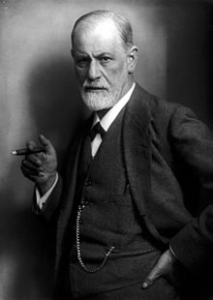
Etiology
oedipal conflict
(Vagina Dentata)

Slide 10
etiology
Biological factors
Body Dysmorphic Disorder
Depression
Anxiety
ADHD

Slide 11
etiology
Sex orientation
Gender dysphoria

Slide 12
Attitudes toward sex
Many Chinese physicians believe that semen loss disrupts the balance between yin and yang and makes men susceptible to disease.
In India, the Ayrvedic medical system teaches that men who lose too much semen presumably experience malaise, bodily weakness, and wasting away.
Self fulfilling prophecy

Slide 13
The meaning of Sex
spiritual transcendence
Sin
Power
Weakness
the procreation of children
romantic intimacy
erotic pleasure
recreation

Slide 14
Love and sex are strongly correlated

Slide 15
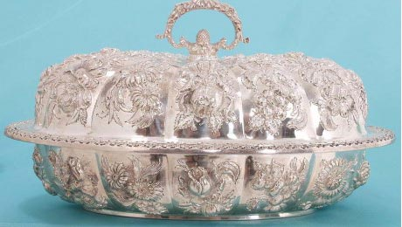
Madonna-Whore Complex

Slide 16
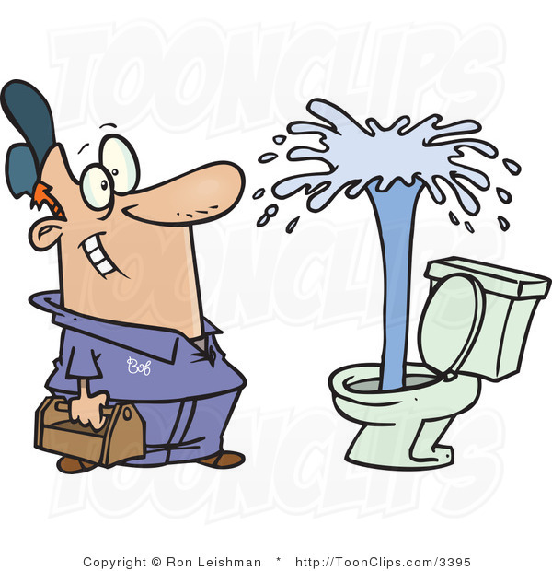
Fantasy vs. Reality

Slide 17
Sex language
Scientific language
Dirty words
Metaphoric language

Slide 18
Dual sex therapy
The theoretical basis of the dual-sex therapy approach is the concept of the
marital unit or dyad as the object of therapy.
The sexual problem often reflects other areas of disharmony or
misunderstanding in the marriage. The marital relationship as a whole is
treated, with emphasis on sexual functioning as a part of that relationship.

Slide 19
treatment
Couple therapy
Therapy of underlying problem
Psychotherapy

Slide 20
treatment
Ginseng has been reported to have androgenic effects
Dopaminergic agents have been reported to increase libido and improve sex function.( L-dopa, bromocriptine)
The antidepressant:
bupropion
Selegiline, an MAOI, is selective for MAOB.

Slide 21
treatment
Androgens increase the sex drive in women and in
men with low testosterone concentrations.
Testosterone can be administered to men through
injections, transdermal patches, or as gels, creams. Oral
preparations are associated with increased risk of hepatotoxicity.

Slide 22
treatment
Clomiphene, usually used as a fertility drug for women, also stimulates testosterone production
GnRH

Slide 23
treatment
Estrogen and progesterone are compulsive sexual behavior in
men, usually in sex offenders.
Medroxyprogesterone acetate (Depo-Provera),
Cyproterone acetate is a strong antiandrogen
Sex drive disappears within 2 weeks.

Slide 24
Thank you for your attention!
hafezbajoghli@yahoo.com

