Slide 1
IN THE NAME OF GOD

Slide 2
Assessing Nicotine Dependence
Kheradmand Ali M.D.
Assistant Professor of Psychiatry
Shahid Beheshti University of
Medical Sciences

Slide 3
Assessment Strategies
1-The CAGE questionnaire for smoking
2-The “four Cs” test
3-The Fagerström Test for Nicotine Dependence
4-Smoker’s Profile
5-Assessing reinforcement
6-Readiness to change

Slide 4
1- CAGE Questionnaire
The CAGE questionnaire is a simple, accurate tool that has been used for many years to screen patients for addictive disorders.
The CAGE questions have been revised to apply to smoking behavior , and can be included in a clinical interview. It modified from the familiar CAGE questionnaire for alcoholism.

Slide 5
CAGE Questionnaire Modified for Smoking Behavior
Examples of actual patient responses to these questions include the following:
Cut down: “I wanted to quit smoking, but I couldn't do it, so I switched to a low-tar cigarette.”
Annoyed: “Last week, my granddaughter said to me, ‘Grandma, I wish you would stop smoking,’ and I snapped at her, ‘Well, I'm old enough to smoke—are you?’”
Guilty: “I should have stopped smoking long ago—my family wouldn't have to suffer on my account like this if I had.”
Eye-opener: “I smoke my first cigarette before my feet hit the floor.”

Slide 6
CAGE Questionnaire Modified for Smoking Behavior
Have you ever felt a need to Cut down or control your smoking, but had difficulty doing so?
2. Do you ever get Annoyed or angry with people who criticize your smoking or tell you that you ought to quit smoking?
3.Have you ever felt Guilty about your smoking or about something you did while smoking?
4. Do you ever smoke within half an hour of waking up (Eye-opener)?
Two “yes” responses constitute a positive screening test.
Information from Lairson DR, Harrist R, Martin DW, Ramby R, Rustin TA, Swint JM, et al. Screening for patients with alcohol problems: severity of patients identified by the CAGE. J Drug Educ 1992;22:337–52.

Slide 7
2-‘Four Cs’ Test
Psychiatrists, psychotherapists, social workers and addiction counselors rely on criteria in the Diagnostic and Statistical Manual of Mental Disorders (DSM) to diagnose substance dependence.
These criteria apply to all addictive substances (e.g., alcohol,opioids,cannabis,amphetamines) and can be grouped into four categories that conveniently begin with the letter “C”

Slide 8
‘Four Cs’ Test
  Compulsion—the intensity with which the desire to use a chemical overwhelms the patient's thoughts, feelings and judgment.
  Control—the degree to which patients can (or cannot) control their chemical use once they have started using.
  Cutting down—the effects of reducing chemical intake; withdrawal symptoms.
  Consequences—denial or acceptance of the damage caused by the chemical

Slide 9
‘Four Cs’ Test
Family physicians who feel comfortable discussing psychological issues with their patients may prefer this approach, which documents a DSM–based diagnosis of nicotine dependence.

Slide 10
Assessing Nicotine Addiction Using the “Four Cs” Test
Compulsion
Do you ever smoke more that you intend?
Have you ever neglected a responsibility because you were smoking, or so you could smoke?
Control
Have you felt the need to control how much you smoke but were unable to do so easily?
Have you ever promised that you would quit smoking and bought a pack of cigarettes that same day?
Cutting down (and withdrawal symptoms)
Have you ever tried to stop smoking? How many times? For how long?
Have you ever had any of the following symptoms when you went for a while without a cigarette: agitation, difficulty concentrating, irritability, mood swings?
If so, did the symptom go away after you smoked a cigarette?
Consequences
How long have you known that smoking was hurting your body?
If you continue to smoke, how long do you expect to live?
If you were able to quit smoking today and never start again, how long do you think you might live?

Slide 11
3-Fagerström Test
Patients who quit smoking and relapse within two or three weeks usually do so to relieve withdrawal symptoms secondary to their physical dependence on nicotine.
The Fagerström Test for Nicotine Dependence is a standard instrument for assessing the intensity of this physical addiction.
The Fagerström test helps family physicians document the indications for prescribing medication for nicotine withdrawal.

Slide 12
Fagerström Test
The higher the Fagerström score, the more intense is the patient's physical dependence on nicotine.
Higher scores indicate that treatment of withdrawal symptoms, usually with nicotine replacement therapy, will be an important factor in the patient's plan of care.

Slide 13
Modified Fagerström Test for Nicotine Dependence
1. How soon after you wake up do you smoke your first cigarette? 3 - Within 5 minutes 2 - 6-30 minutes 1 - 31-60 minutes 0 - After 60 minutes
2. Do you find it difficult to refrain from smoking in places where it is forbidden (e.g. in church, at the library, cinema, etc.)?
1 – Yes 0 - No
3. Which cigarette would you hate to give up?
1 - The first one in the morning 0 - All the others
4. How many cigarettes/day do you smoke?
0 - 10 or less 1 - 11-20 2 - 21-30 3 - 31 or more
5. Do you smoke more frequently during the first hours after waking than during the rest of the day?
1 – Yes 0 - No
6. Do you smoke if you are so ill you are in bed most of the day?
1 – Yes 0 – No
.

Slide 14
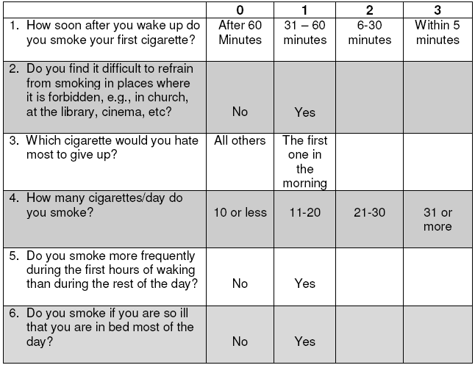
Modified Fagerström Test for Nicotine Dependence

Slide 15
Modified Fagerström Test for Nicotine Dependence
Classification of dependence:
Less than 4 : minimally dependent
4-6 : moderately dependent
7-10 : highly dependent
Adapted with permission from Heatherton TF, Kozlowski LT, Frecker RC,Fagerström KO. The Fagerström test for nicotine dependence: a revision of the Fagerström Tolerance Questionnaire. Br J Addict 1991;86:1119–27.

Slide 16
Heaviness of Smoking Index (HSI)
The Heaviness of Smoking Index (HSI) consists of FTND Item 1 and FTND Item 4, using the same response scales and calculating the total score using the sum of the scores on those two items.
  How soon after you wake up do you smoke your first cigarette? 3 - Within 5 minutes 2 - 6-30 minutes 1 - 31-60 minutes 0 - After 60 minutes
  How many cigarettes/day do you smoke?
0 - 10 or less 1 - 11-20 2 - 21-30 3 - 31 or more

Slide 17
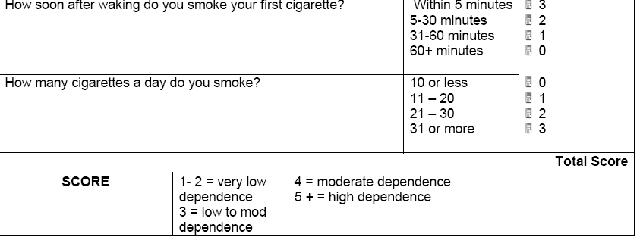
Heaviness of Smoking Index (HSI)

Slide 18
4-Assessing Reinforcement
Patients who quit smoking but relapse more than six weeks later are not smoking to relieve withdrawal symptoms; their relapses are caused by a desire to smoke (craving) induced by internal or external events.
Assessing how each patient's smoking serves as a reinforcer can help the family physician identify potential relapse triggers for that person.

Slide 19
Assessing Reinforcement
Asking the following questions of a patient can help identify the reinforcing aspects of smoking behavior:
SENSORY REWARDS
“Lots of smokers like the way a cigarette feels in their fingers. Or, they enjoy the puffing, the smoke and the warmth of a cigarette. What about you?”
RITUALS
“Lots of smokers have special things they like to do with a cigarette, such as what they do with the cigarette pack, the way they open it, the way they light up and the way they puff on the cigarette. What about you?”
IMAGE
“What sort of people smoke (the patient's brand of cigarettes)? What are they like?”
EMOTIONAL RELIEF
“Lots of smokers discover that cigarettes help them deal with stressful feelings, such as anger, frustration or boredom. What about you?”

Slide 20
5-Smoker's Profile
Elements gathered from the preceding assessments have been formulated into a smoker's profile;
The smoker's profile scores the intensity of the following four reasons that people smoke cigarettes:
  to relieve stress
  to perform a conditioned response
  to relieve withdrawal symptoms
  to treat an underlying depressive state

Slide 21
A. Smoker's Profile-Stress relief
When you're frustrated or angry, do you automatically think about smoking a cigarette?
If you're upset or scared, does a cigarette help you calm down?
Do you rely on cigarettes when you're under stress?
Recall a time when you stopped smoking for a while. After you stopped smoking, did you want a cigarette more whenever you got upset or angry? Did you miss cigarettes more when you were under a lot of stress or tension?

Slide 22
B. Smoker's Profile-Conditioned responses
How often do you smoke while you're driving a car or drinking a cup of coffee?
If you're with someone who's smoking, do you automatically smoke, too?
Do you usually smoke a cigarette during or after a meal?
Recall a time when you stopped smoking for a while. Did being around smokers make it hard to not smoke? Were there certain people, places or things that made you want to smoke?

Slide 23
C. Smoker's Profile-Relief of withdrawal symptoms
When do you smoke your first cigarette of the day?
Do you get irritable if you have to go more than two hours without a cigarette?
Do you have trouble concentrating if you're not smoking?
Recall a time when you stopped smoking for a while. Did you get irritable or moody during the first few days after you stopped? Did you have trouble concentrating during the first few days after you stopped?

Slide 24
D. Smoker's Profile-Elevation of depressed mood
Recall a time when you stopped smoking for a while. Did you become more depressed?
When you woke up in the morning, did you feel that you could spend all day in bed?
How was your energy level after you stopped smoking?

Slide 25
6-Readiness to Change
After using one or more of the assessment tools, the family physician will have sufficient information to know what a patient needs to do to quit smoking.
Knowing the patient's cognitive set is crucial to success in quitting smoking because advice and treatment must match the patient's cognitive stage to be effective.

Slide 26
Readiness to Change
The Transtheoretical Model of Change is based on discrete stages along the continuum of change in cigarette smoking behavior. These stages are termed:
pre contemplation
contemplation
preparation
action
maintenance
relapse

Slide 27
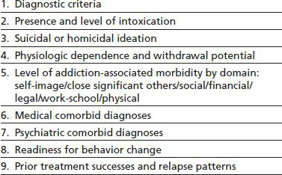
TASKS OF THE ASSESSMENT PROCESS

Slide 28
Pack-year
Number of pack-years = (packs smoked per day) × (years as a smoker)
or
Number of pack-years = (number of cigarettes smoked per day/20) × number of years smoked. (1 pack has 20 cigarettes in some countries)
1 pack-year = 1 pack day *1 year = 1 pack day*365.24 days = 365.24 packs = 365.24 packs * 20 cigarettes pack = 7305 cigarettes
For example:
a person who has smoked 15 cigarettes a day for 40 years has a (15/20) x 40 = 30 pack-year smoking history.
A pack-year is smoking 20 cigarettes a day for one year.
If someone has smoked 10 cigarettes a day for 6 years they would have a 3 pack-year history.
Someone who has smoked 40 cigarettes daily for 20 years has a 40 pack-year history.

Slide 29
References:
R.K. Reis, D.A. Fiellin, Sh.C. Miller, R.SAITZ. The ASAM principles of Addiction Medicine, Fifth Edition,2014
American Family Physician, www.aafp.org

